Slide 1
Topic 16 Entropy Balance
Thermodynamics: An Engineering Approach
8th Edition Yunus A. Çengel, Michael A. Boles
McGraw-Hill, 2015

Slide 2
Objectives
Introduce and apply the entropy balance to various systems.

Slide 3
ENTROPY BALANCE
Entropy Change of a System, ∆S_{system}
When the properties of the system are not uniform
Energy and entropy balances for a system.

Slide 4
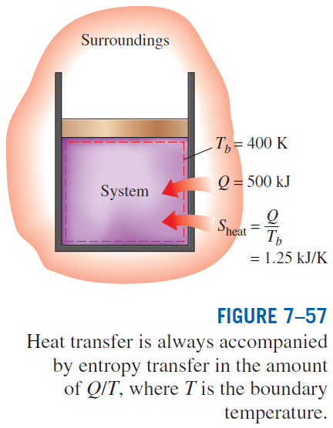
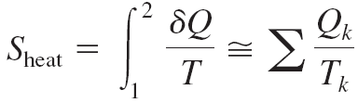
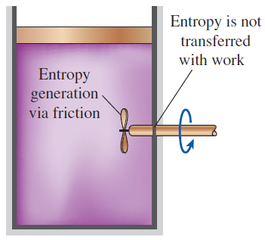
Mechanisms of Entropy Transfer, S_{in} and S_{out}
1 Heat Transfer
Entropy transfer by heat transfer:
Entropy transfer by work:
No entropy accompanies work as it crosses the system boundary. But entropy may be generated within the system as work is dissipated into a less useful form of energy.

Slide 5
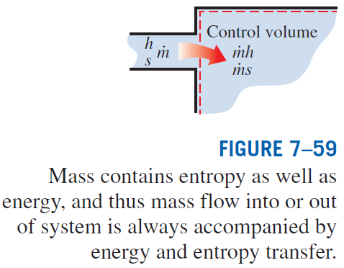
2 Mass Flow
Entropy transfer by mass:
When the properties of the mass change during the process

Slide 6
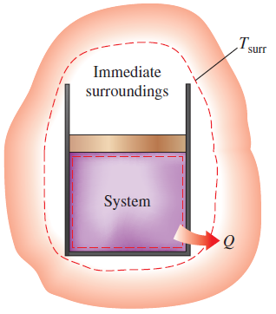
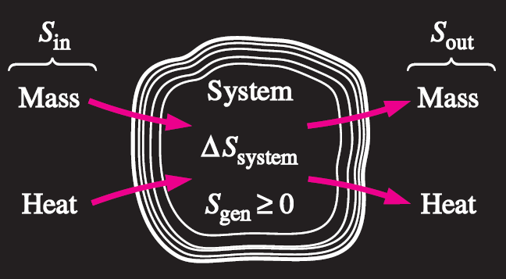
Entropy Generation, S_{gen}
Entropy generation outside system boundaries can be accounted for by writing an entropy balance on an extended system that includes the system and its immediate
surroundings.
Mechanisms of entropy transfer for a general system.

Slide 7
Closed Systems
The entropy change of a closed system during a process is equal to the sum of the net entropy transferred through the system boundary by heat transfer and the entropy generated within the system boundaries.

Slide 8

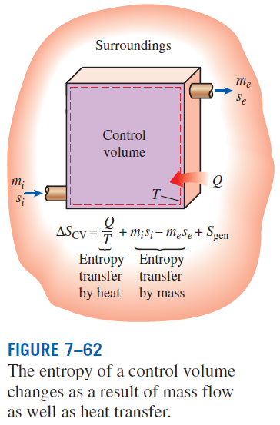

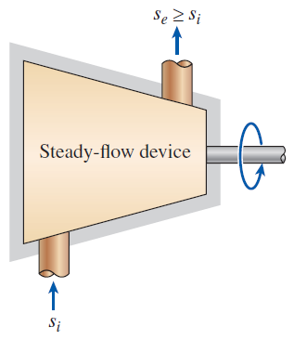
Control Volumes
The entropy of a substance always increases (or remains constant in the case of a reversible process) as it flows through a single-stream, adiabatic, steady-flow device.

Slide 9
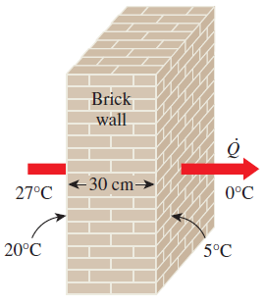
Entropy Generation in a Wall
Consider steady heat transfer through a 5 m x 7 m brick wall with a thickness of 30 cm. On one side the wall, the room temperature of a house is 27ºC; the outside temperature on the other side is 0ºC. The temperature of the inner and outer surfaces are 20ºC and 5ºC, respectively, and the rate of heat transfer is measured to be 1035 W. Determine the rate of entropy generation in the wall and the rate of total entropy generation associated with the heat transfer process.
Example 1

Slide 10
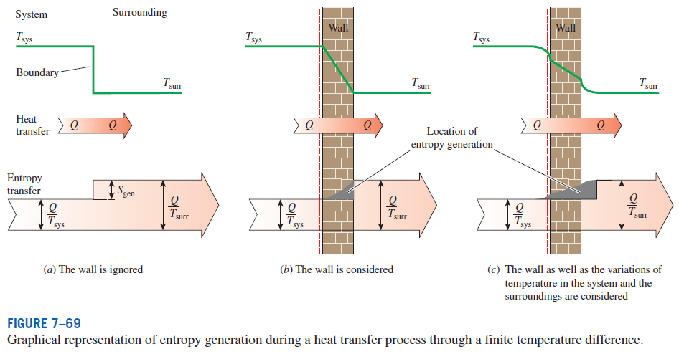
Entropy generation associated with a heat transfer process

Slide 11
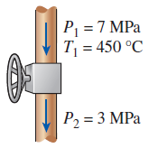
Entropy Generation During a Throttling Process
Steam at 7 MPa and 450ºC is throttled in a valve to a pressure of 3 MPa during a steady-flow process. Determine the entropy generated during this process and whether it satisfies the second law of thermodynamics.
Example 2

Slide 12
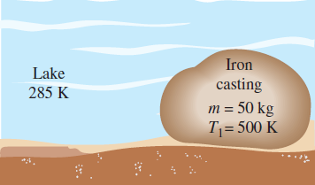
Entropy Generated when a Hot Block is Dropped in a Lake
A 50-kg block of iron casting at 500 K is thrown into a large lake that is at a temperature of 285 K. The iron block eventually reaches thermal equilibrium with the lake water. Assuming an average specific heat of 0.45 kJ/kg K for the iron, determine the entropy changes of the block and of the lake and the entropy generated during the process.
Example 3

Slide 13
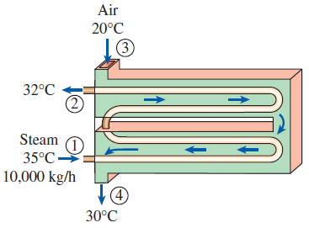
Entropy Generation in a Heat Exchanger
Air in a large building is kept warm by heating it with steam in a heat exchanger. Saturated water vapor enters the unit at 35ºC at a rate of 10,000 kg/hr and leaves as saturated liquid at 32ºC. Air at 1 atm enters the unit at 20ºC and leaves at 30ºC at about the same pressure. Determine the rate of entropy generated during this process.
Example 4

Slide 14
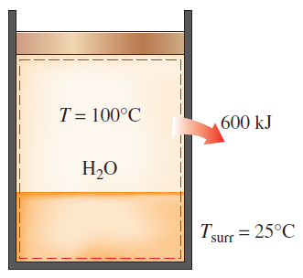
Entropy Generation Associated with Heat Transfer
A frictionless piston-cylinder device contains a saturated liquid-vapor mixture of water at 100ºC. During a constant pressure process, 600 kJ of heat is transferred to the surrounding air at 25ºC. As a result, part of the vapor condenses . Determine the entropy change of the water and the entropy generation during the heat transfer process.
Example 5

Slide 15
Summary
Entropy balance

